Slide 1
Updates on Documentation, Literature Reviews and Timeline

Slide 2
SUGGESTED CONTENT (1) (INTRODUCTION)
The website aims to serve as a centralized platform for storing code, accessing machine learning models through an API, and providing users with insights into relevant materials obtained from various online databases. It also serves as a hub for collaboration and information exchange within the team.

Slide 3

SUGGESTED CONTENT (2) (GOALS)
• Code Storage:
The website will keep and organize the team's code for machine learning models and API development.
• API Use:
Team members and outside partners can use the website to connect to the team's machine learning models. The models take in data and provide information about materials from various online databases.
• Results Display:
Users can see the results of the machine learning models on the website, making it easier to understand and make decisions based on the outcomes.

Slide 4

SUGGESTED CONTENT (3) (LITERATURE REVIEWS)
Accelerated Discovery of Efficient Solar-cell Materials using Quantum and Machine-learning Methods.
Toward Predicting Efficiency of Organic Solar Cells via Machine Learning and Improved Descriptors
Machine Learning Approach to Delineate the Impact of Material Properties on Solar Cell Device Physics
Exploring optical properties of solar cells by programming and modeling
The annealing effects of tungsten oxide interlayer based on organic photovoltaic cells

Slide 5


Literature Review Summary
L1
Title: Accelerated Discovery of Efficient Solar-cell Materials
using Quantum and Machine-learning Methods.
The research focused on identifying potential solar cell materials with high efficiency by combining density functional theory (DFT) high-throughput screening and machine learning techniques .
The study identified 58 potential 2D-bulk solar cell materials with high potential as thin-film solar-cell materials .
A machine learning classification model was trained with the spectroscopy limited maximum efficiency (SLME) data to predict whether a material will have an SLME above 10% .
PDF can be downloaded here
Density functional theory (DFT) high-throughput screening was employed to analyze a large volume of materials data with high accuracy .
The researchers utilized the meta-GGA TBmBJ formalism to obtain frequency-dependent dielectric function data for investigating materials.
Effective carrier mass and energy above the convex hull were used to screen candidate materials for high-efficiency solar applications.
Machine learning techniques were applied to classify materials based on SLME data and accelerate the discovery of photovoltaic materials.
The study provides a comprehensive suite of data, tools, and methodologies to expedite the discovery of photovoltaic materials, potentially impacting the next generation of materials design.
By leveraging advanced computational methods and machine learning, the research offers a promising approach to identifying efficient solar cell materials from crystallographic information and chemical constituents.
The integration of DFT calculations, dielectric function data, and machine learning models showcases a multidisciplinary approach to materials discovery for renewable energy applications.

Slide 6
Literature Review Summary
L2
Title: Toward Predicting Efficiency of Organic Solar Cells via Machine Learning and Improved Descriptors
The research focuses on predicting the efficiency of organic solar cells using machine learning models based on relevant microscopic properties of donor/acceptor molecules as descriptors .
The study emphasizes the importance of considering orbitals energetically close to frontier orbitals of donor molecules in the energy conversion process of organic photovoltaics.
The dataset of 280 experimental systems is utilized to reveal correlations between organic molecule properties and device performance, leading to the identification of potential new candidates for OPVs .
PDF can be downloaded here
Quantum chemical calculations were performed using the Gaussian 09 package to optimize ground state geometries of molecules and calculate various descriptors such as IP(v), λh, and Ebind.
Machine learning techniques accessible from Scikit-Learn were employed to build models using a set of descriptors as input to predict PCE.
Advanced methods like artificial neural networks, random forest, and gradient boosting regression tree were utilized to develop predictive models for PCE.
The study highlights the need to revisit the importance of occupied and unoccupied orbitals of organic materials in OPVs, especially for molecules with small HOMO-LUMO energy gaps.
By leveraging machine learning models, researchers can quickly screen and identify lead candidate materials for organic solar cells before engaging in laborious synthesis and device fabrication.
The use of advanced ML techniques like gradient boosting has shown promising results in predicting PCE for high-throughput virtual screening of new donor molecules for OPVs.

Slide 7
Literature Review Summary
L3
Title : Machine Learning Approach to Delineate the Impact of Material Properties on Solar Cell Device Physics
The research focused on understanding the factors influencing solar device efficiency, particularly the normalized efficiency to power input ratio.
The device structure included layers such as an antireflective coating, glass, FTO electrode, ETL, perovskite layer, HTL, and electrode layer.
Noble metals like Au, Ag, and Pt were commonly used as electrode materials to reduce electron-hole recombination.
The perovskite layer plays a crucial role in absorbing light to create electron-hole pairs for generating electric current.
TiO2 was utilized as the ETL, while Cu2O acted as the HTL in the investigated solar device structure.
PDF can be downloaded here
SCAPS simulation software was employed to study the solar device and investigate the impact of material parameters on efficiency.
Machine learning algorithms, particularly random forest models, were utilized to analyze the dataset and determine the relative importance of input material parameters.
Feature Importance and SHAP analysis were conducted to identify the most influential features affecting the target variable (device efficiency).
Machine learning, as a subfield of artificial intelligence, has become a vital tool in various STEM disciplines, including material science.
Perovskite materials have shown promising results for light capture and are crucial for enhancing solar cell performance.
The study provided insights into how varying material parameters can impact the efficiency of solar devices, aiding experimentalists in optimizing device performance.

Slide 8
Literature Review Summary
L4
Title : Exploring optical properties of solar cells by programming and modeling
The research explores the optical properties of solar cells, focusing on reducing reflected light to increase efficiency.
The study shows that the absorption and reflection factors of a solar cell coated with an anti-reflective layer of SiO2 depend on the thickness of the layer and the wavelength of light.
By using the transfer matrix method, the authors were able to determine the optical properties of silicon-based solar cells with different coatings, such as SiO2 and perovskite Cs17Br17.
PDF can be downloaded here
The research employs the transfer matrix method to calculate the absorption and reflection coefficients of solar cells with anti-reflective coatings.
Programming and modeling techniques were utilized to analyze the optical properties of solar cells at different thicknesses of SiO2 coatings.
The study also visualized and graphed the results obtained through Svisual to provide a comprehensive analysis of the defined parameters.
The refractive index of silicon and air plays a crucial role in the efficiency of solar cells, with the refractive index of silicon ranging from 3-4 depending on the wavelength of light.
Covering the surface of a solar cell with a 100 nm thick SiO2 layer is recommended to improve optical properties and increase efficiency.
The research suggests that by enhancing the optical properties of solar cells, it is possible to achieve economic success by reducing costs and increasing efficiency.

Slide 9
Literature Review Summary
L5
Title : The annealing effects of tungsten oxide interlayer based on organic photovoltaic cells
The study demonstrated that using a tungsten oxide interlayer between ITO and P3HT:PCBM in organic photovoltaic cells can significantly improve device performance.
The device with a 40 nm thick WO3 film annealed at 350°C showed the highest fill factor (FF) and power conversion efficiency (PCE) among the tested configurations.
Annealing the WO3 film led to increased hydrophobicity, improved P3HT crystallization, and enhanced hole mobility in the device.
The increased work function of the annealed WO3 film improved hole-collection efficiency by reducing the barrier between P3HT and ITO.
Surface analysis techniques such as Atomic Force Microscopy (AFM), X-ray Photoelectron Spectroscopy (XPS), and X-ray Diffraction (XRD) were used to study the effects of annealing on the WO3 film.
Current density-voltage curves and work function variations were measured to assess hole mobility and interfacial properties.
XRD spectra of P3HT films on WO3 interlayers were analyzed to understand the structural changes induced by annealing.
PDF can be downloaded here
The annealing process of the WO3 film resulted in improved device performance by enhancing the properties of the P3HT layer and reducing interfacial barriers.
The study highlights the importance of interlayers in organic photovoltaic cells for efficient charge transport and collection.
The findings suggest that heat-treated WO3 films can serve as effective hole collection materials in organic photovoltaic devices.

Slide 10
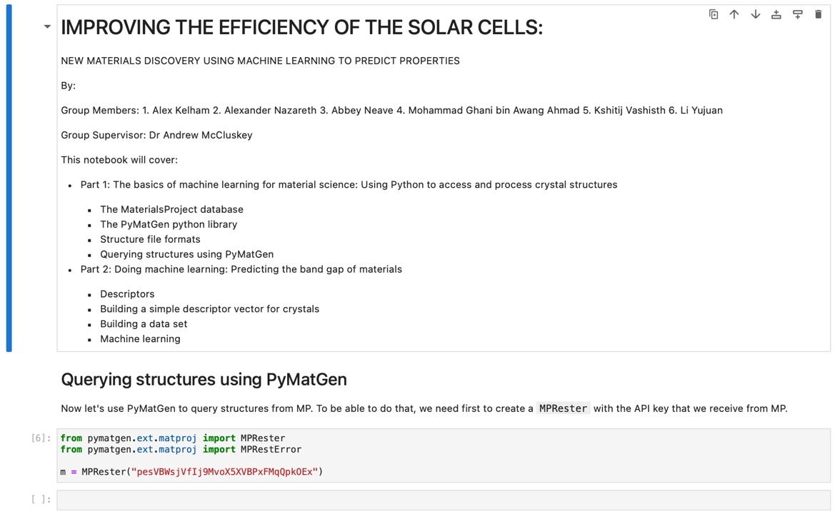
SUGGESTED CONTENT (4) (CODE DOCUMENTATION)

Slide 11

SUGGESTED CONTENT (5) (OUR PROJECT TIMELINE)

